Slide 1
Gradient Descent
ENG . Mahmoud ragab

Slide 2
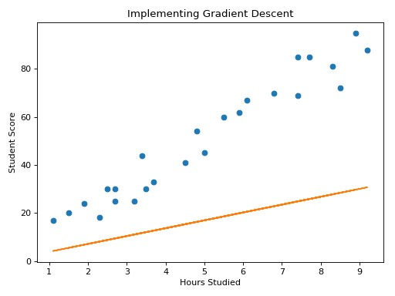
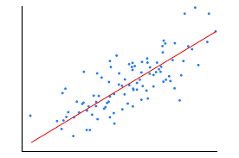
Before Gradient Descent
After Gradient Descent

Slide 3
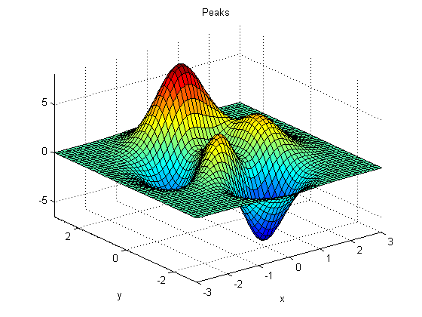
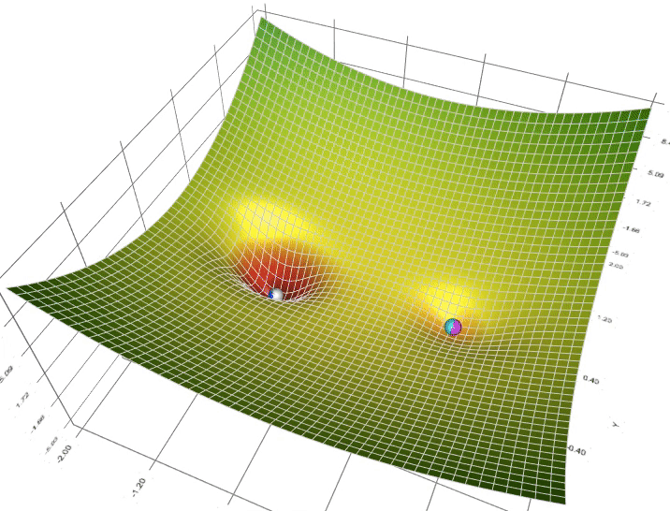
First, we determine the values of θ, and then we gradually reduce those values until we reach the lowest value of the Cost function “J”.
Global Maximum
Local Maximum
Local Minimum
Saddle Point
Global Minimum

Slide 4
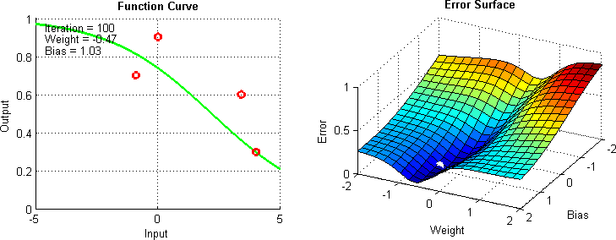
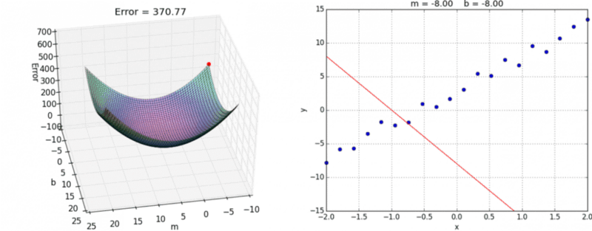

Slide 5
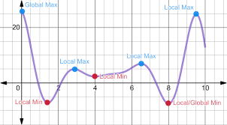
local and global points

Slide 6
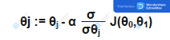
Gradient Descent Equation
The sign “ := “ makes overwrite for the left value with the right value
The symbol “ α ” is the learning rate, if it increases, the steps will be faster (and less accurate), and if it is less, it will be slower but more accurate
What to the right of the alpha is a partial derivative of the function with respect to theta
Both equations run together in parallel, and are repeated together once for θ0 and the other for θ1.

Slide 7
Idea :-
When we reach the global minimum value, the differential value is 0
The lower the slope, the lower the differential value, so when the minimum value is reached, the slope is 0, and therefore the differential is 0

Slide 8
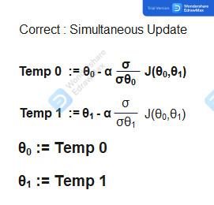
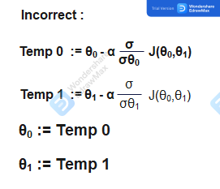

Slide 9
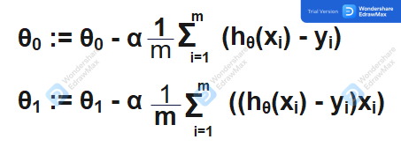
Gradient Descent Equation

Slide 10
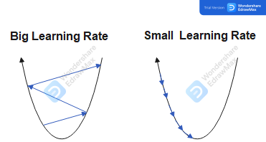
Alpha value

Slide 11
Practical example
home space (X)
Price (Y)
Assuming that:
Θ_{0 = 1 ,} Θ₁ ₌ ₃
H(x) = 1 + 3x
100
135
95
130
90
110
80
95
80
90
70
85
70
80
60
80

Slide 12
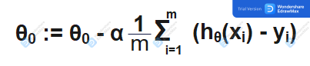
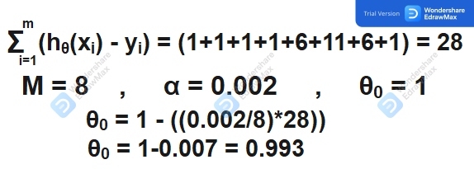
X
Y
H(x)
H(x)-Y
Solution
100
300
301
1
95
285
286
1
90
270
271
1
80
240
241
1
80
235
241
6
70
200
211
11
70
205
211
6
60
180
181
1

Slide 13
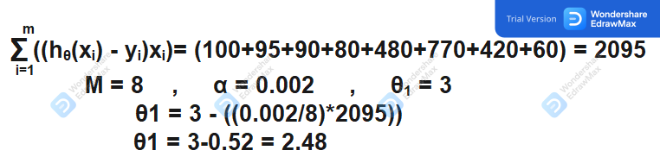
X
Y
H(x)
H(x)-Y
(H(X)-Y)X
100
300
301
1
100
95
285
286
1
95
90
270
271
1
90
80
240
241
1
80
80
235
241
6
480
70
200
211
11
770
70
205
211
6
420
60
180
181
1
60

Slide 14
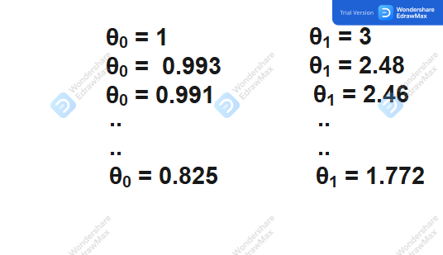

Slide 15

any questions ?

